Slide 1
Autonomous Coffee Machine
Scott White

Slide 2
Product Description
Wi-Fi enabled coffee machine that can be controlled remotely
Autonomous in the sense that the brew setup is completely hands free, with the exception of manually cleaning the filters
This machine will eliminate the headache of having to setup your coffee and wait for the brew to finish

Slide 3
Product Features
Wi-Fi Enabled for remote control
Multi-Cup Brewing as a user option
Brew Strength as user option
Senses and prevents brewing when filters are dirty
Keeps coffee warm for the perfect amount of time
Database to store use information (Hopefully)

Slide 4
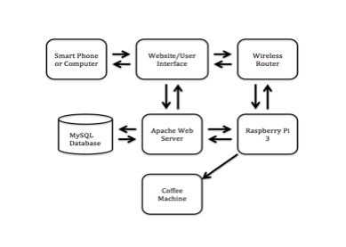
High Level System Design

Slide 5
Product Users
Primary Markets
Home Owners & Small Businesses
A scaled version of this machine could target other markets including:
Large Corporate Offices
Gas Stations
Coffee Shops

Slide 6
User Requirements
Requires the user to setup a raspberry pi appropriately
Network Connection on Pi and Personal Device
A decent amount of available counter space
This would probably would require a customer support line due to the setup requirements and possible IT issues.

Slide 7
Specifications
Height and surface area to conserve counter space (Not going to meet this goal)
Temperature of coffee after brewing should be about 190-205 degrees Fahrenheit
Machine should be able to brew 2-12 cups
Voltage level the user could be exposed too
User can control how many cups and strength of coffee of the brew. (Simple User Interface)
Time and difficulty to setup (Probably won’t meet this goal)

Slide 8
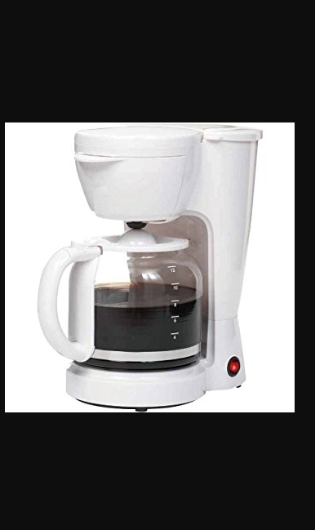
Architectural Design
Before

Slide 9
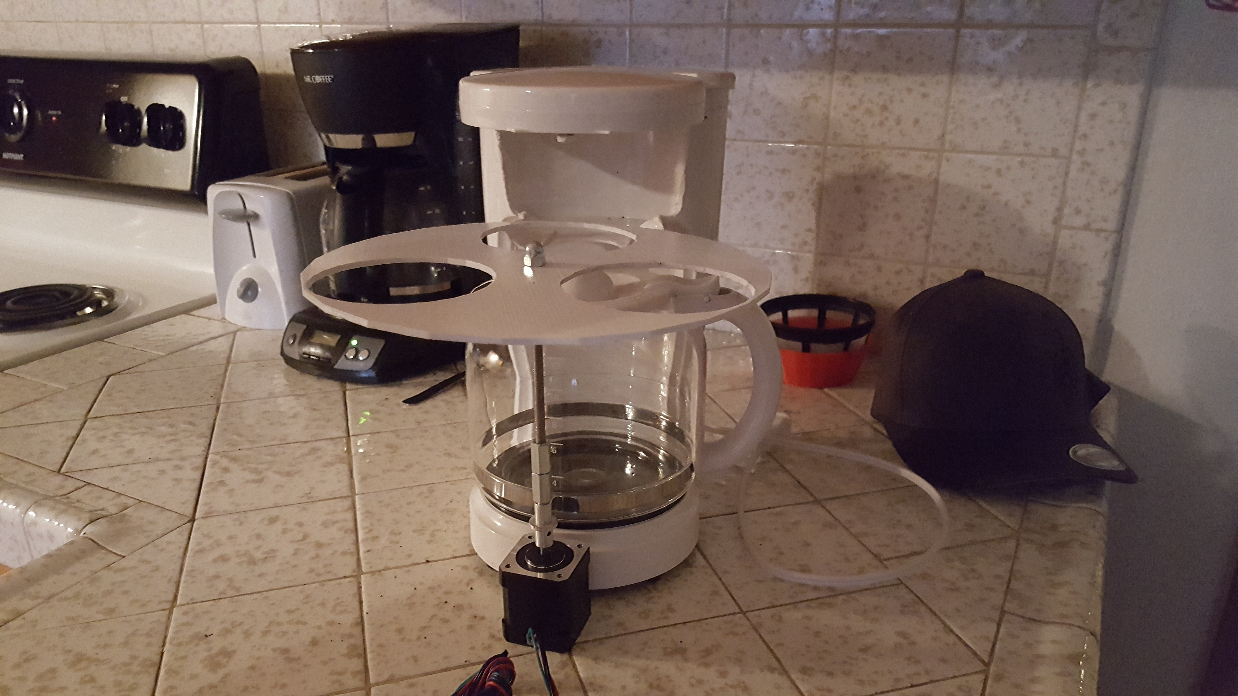
Architectural Design
After

Slide 10
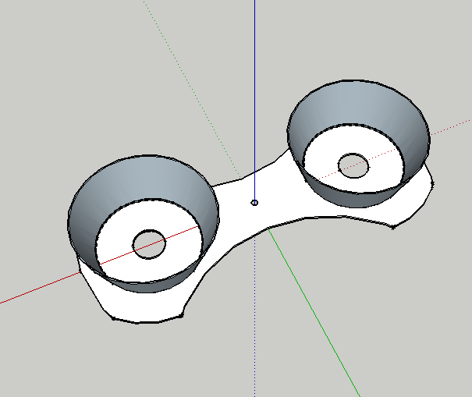
Architectural Design
Final Prototype of Carousel

Slide 11
Architectural Design
Coming soon:
Motor Mount to secure motor to machine
Coffee Reservoir with solenoid valve
Water Reservoir with valve or pump…
Sensor placement
Power Supply Enclosure

Slide 12
Hardware Design
Power Supply
Raspberry Pi 3
H-Bridge
Water Valve
Coffee Valve
Stepper Motor
Burner Control
Sensors

Slide 13
Theory Of Operation
User opens webpage and selects brew parameters
Machine checks sensors to make sure brew is possible
If possible the machine prepares the brew based on users selected parameters and begins brewing
The machine then lets the user know if the brew started or not

Slide 14
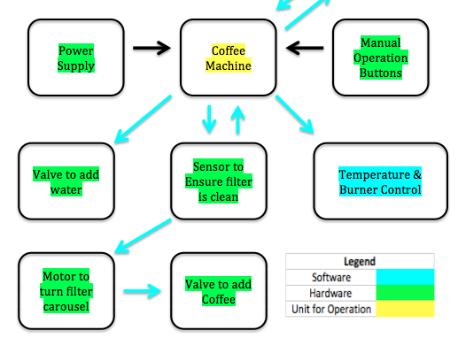
Software Design
Server

Slide 15
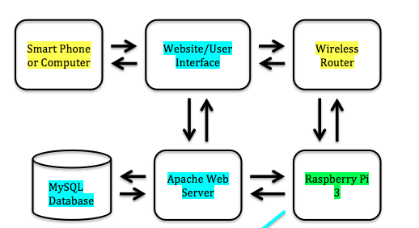
Software Design
Client

Slide 16
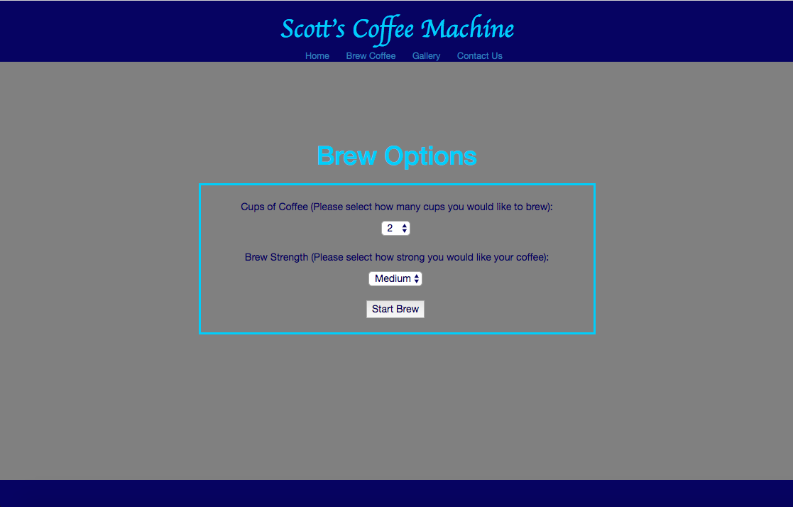
User Interface

Slide 17
Schedule
User Interface – Already Done
Remote Communication with the Pi – Already Done
Mechanical Design – Highest Risk for project completion and currently being designed
Electrical Design – Primarily Building the appropriate power supply
Machine Control – Software should be easy for me and is contingent upon everything else being done

Slide 18
Questions???

